Slide 1

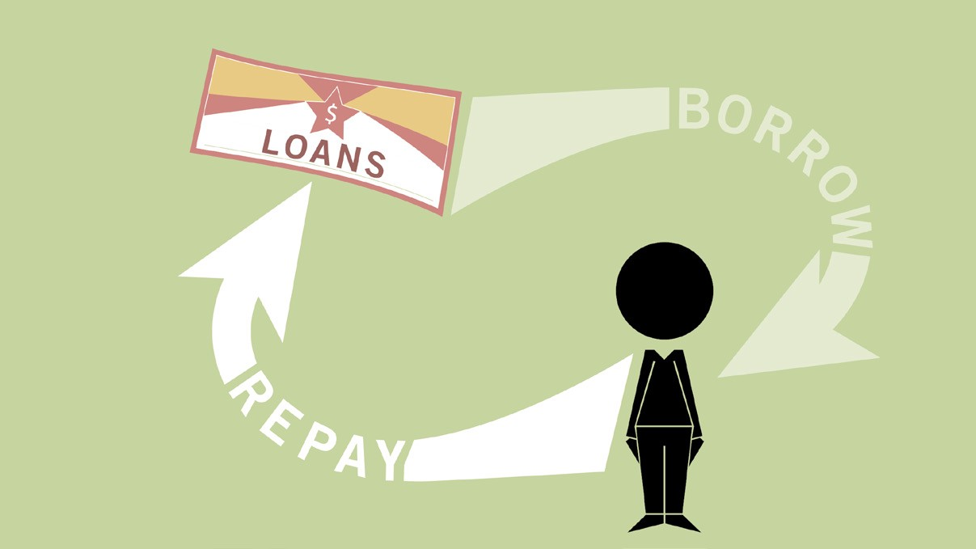
Loan DEFAULT PREDICTION

Slide 2
SUMMARY/GOAL
A bank loan can provide numerous benefits, but it is a risk to both borrower and the lender. The lender runs the risk of lending you the money but not getting fully repaid. And as for borrower’s personal financial health, you can lose money or even your house. This is why lenders employ careful underwriting standards to minimize the risk for both parties.
The analysis of risk in bank loans need understanding what is the meaning of risk. In addition, the number of transactions in banking sector is rapidly growing and huge data volumes are available which represent the customers behavior and the risks around loan are increased.
The two most critical questions in the lending industry are:
How risky is the borrower?
Given the borrower’s risk, should we lend him/her?
The goal of this project is to find a model where we can predict whether a loan would be paid off in full or the loan needs to be charged off and possibly go default

Slide 3
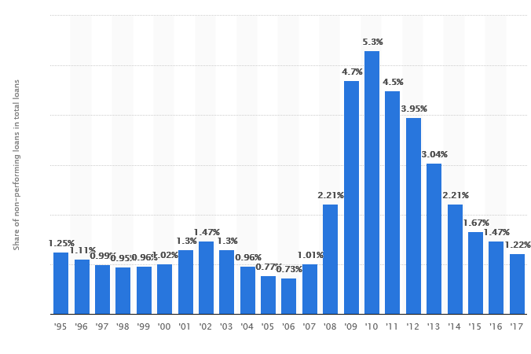
Stats of non-performing loans held by banks in the United States from 1995 to 2017
non-performing loan NPL. A loan on which the borrower is not making interest payments or repaying any principal. At what point the loan is classified as non-performing by the bank, and when it becomes bad debt, depends on local regulations.

Slide 4
APPROACH
Load the loan dataset from lending club
Data Preparation
Dummy features (one-hot encoding)
Build models – Logistic Regression, Classification Trees, and Naive Bayes
Deep Learning
Model evaluation and comparison
Make Predictions

Slide 5
DATA COLLECTION
Collected data from the lending club :
Lending Club (LC) is the world’s largest online marketplace connecting borrowers and investors. It is transforming the banking system to make credit more affordable and investing more rewarding. Lending Club operates at a lower cost than traditional bank lending programs and pass the savings on to borrowers in the form of lower rates and to investors in the form of solid risk-adjusted returns.
The information is available in 2 files.
LOAN DATA - The ﬁle contains complete loan data for all loans issued through the time period stated, including the current loan status (Current, Late, Fully Paid, etc.) and latest payment information.
DECLINED LOAN DATA - The ﬁle contains the list and details of all loan applications that did not meet Lending Club's credit underwriting policy.

Slide 6
Initial Data Exploration
Analysis of Approved Loans
1. Analysis on Loan Amount.
2. Loan amount frequency distribution.
3. Number of Loans over time.
4. Average Loan Amount over time
5. Relationship between Loan Amount and Loan status.
6. Distribution of Loan Amount over Purpose
7. Analysis on Interest Rate.
8. Interest Rate Distribution
9. Relationship between Interest Rate and Term.
Analysis of Probability Of Charge Off
1. Relationship between Location and Probability of Charge Off
2. Relationship between Purpose and Probability of Charge Off
3. Relationship between Interest Rate and Probability of Charge Off
4. Relationship between Annual Income and Probability of Charge Off
5. Relationship between Grade/Sub-grade and Probability of Charge Off
6. Relationship between Employment Length and Probability of Charge Off

Slide 7
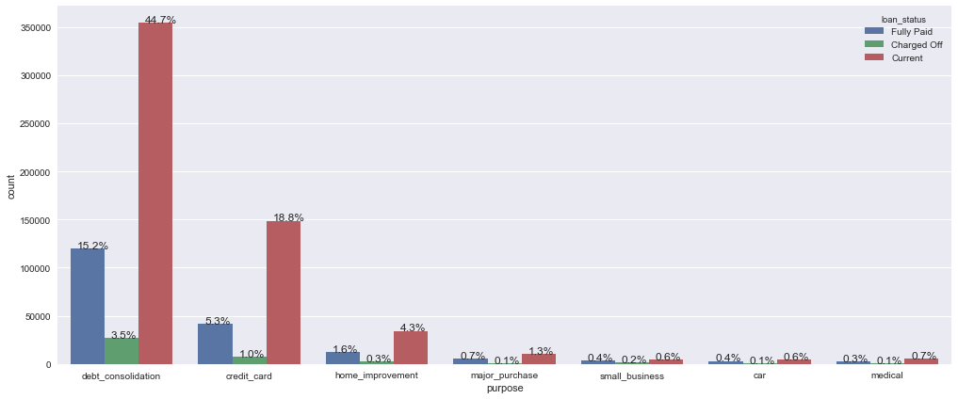
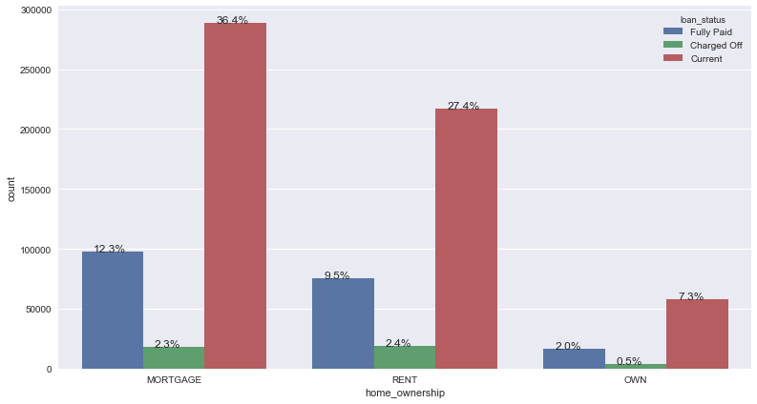
Relationship between Purpose and Loan Status
Relationship between Home Ownership and Loan Status

Slide 8
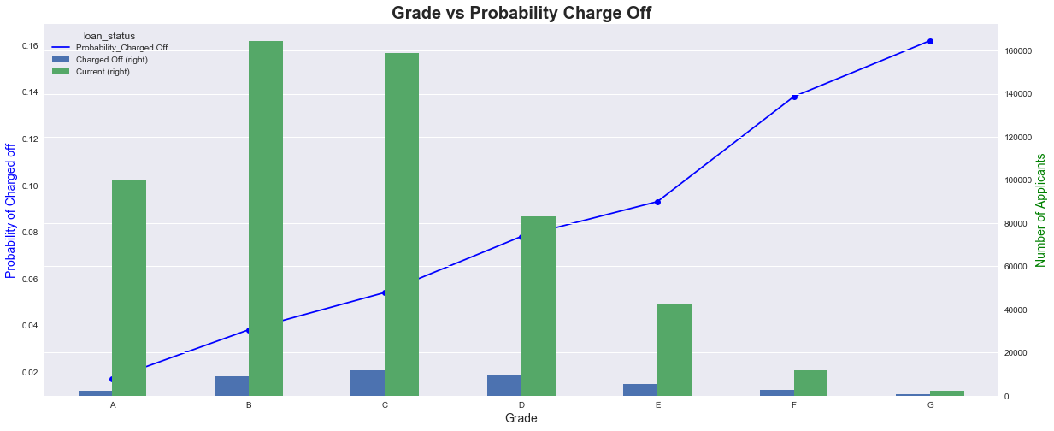
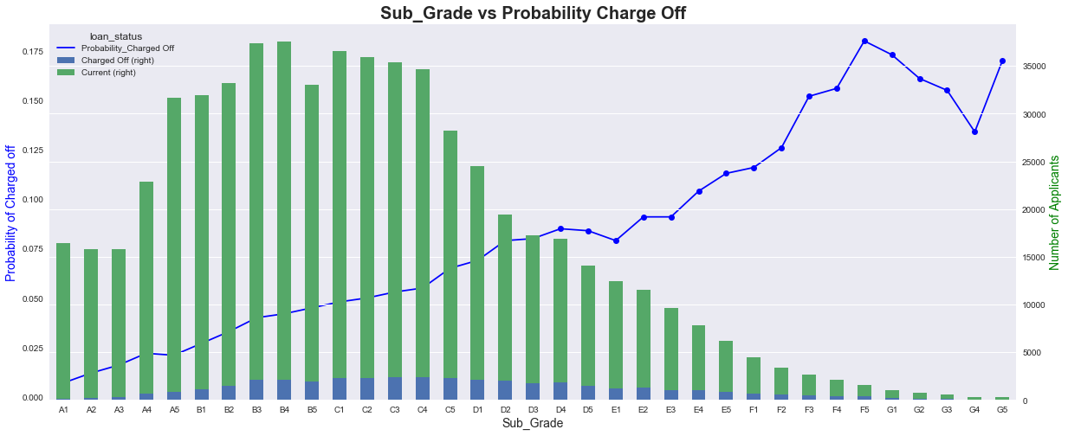
Grade/Sub-Grade vs Probability Charge Off

Slide 9
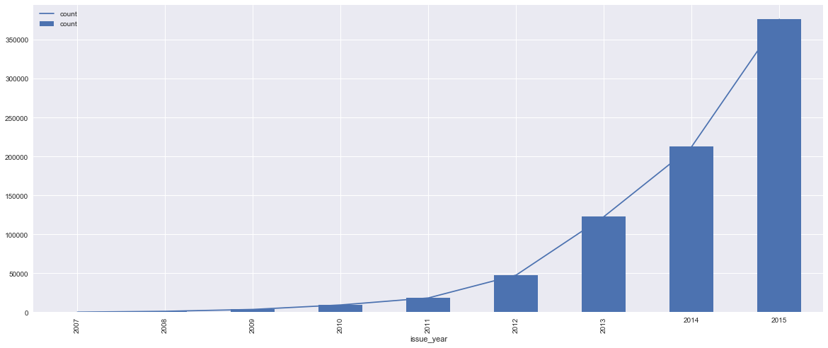
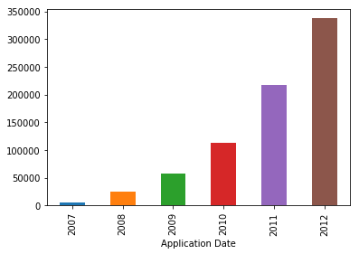
Approved Loans Distribution
Declined Loans Distribution

Slide 10
Dummy Features (One-Hot Encoding)
Home Ownership |  | Home Ownership | Encoding
MORTGAGE |  | home_ownership_MORTGAGE | 0,1
RENT |  | home_ownership_RENT | 0,1
OWN |  | home_ownership_OWN | 0,1
OTHER |  | home_ownership_OTHER | 0,1
NONE |  | home_ownership_NONE | 0,1
Employment Length | Employment Length | Encoding
n/a | emp_length_0 | 0, 1
< 1 year | emp_length_< 1 year | 0, 1
1 year | emp_length_2 years | 0, 1
2 years | emp_length_3 years | 0, 1
3 years | emp_length_4 years | 0, 1
4 years | emp_length_5 years | 0, 1
5 years | emp_length_6 years | 0, 1
6 years | emp_length_7 years | 0, 1
7 years | emp_length_8 years | 0, 1
8 years | emp_length_9 years | 0, 1
9 years | emp_length_10 | 0, 1
10+ years | emp_length_10+ years | 0, 1

Slide 11
Top 20 Feature importance ranking - Random Forest Model
total_rec_prncp: 0.2652
recoveries: 0.2212
last_pymnt_amnt: 0.0871
total_pymnt: 0.079
funded_amnt_inv: 0.074
collection_recovery_fee: 0.0726
installment: 0.0374
total_pymnt_inv: 0.0349
loan_amnt: 0.0347
funded_amnt: 0.0273
id: 0.0195
total_rec_int: 0.0141
sub_grade: 0.0072
member_id: 0.0055
total_rec_late_fee: 0.0036
term: 0.0026
int_rate: 0.0021
tot_cur_bal: 0.0016
revol_util: 0.0016
revol_bal: 0.0015

Slide 12
PREDICTIVE ANALYSIS
Two types of models:
Random Forest, Logistic Regression, Naive Bayes
Deep Learning Model

Slide 13
Evaluating Models
Confusion Matrix/Insight of Bad Loans
Models | Precision | Recall | F1 Score | Support
Random Forest | 100.00% | 100.00% | 100.00% | 51930
Logistic Regression | 100.00% | 100.00% | 100.00% | 51974
Naïve Bayes | 99.00% | 77.00% | 86.00% | 51946

Slide 14
DEEP LEARNING MODEL - PERFORMANCE
Categorial Classification
Multi-Class
Binary
RESULT
Model | Accuracy
Multi-Class | 92.72%
Binary | 99.67%

Slide 15
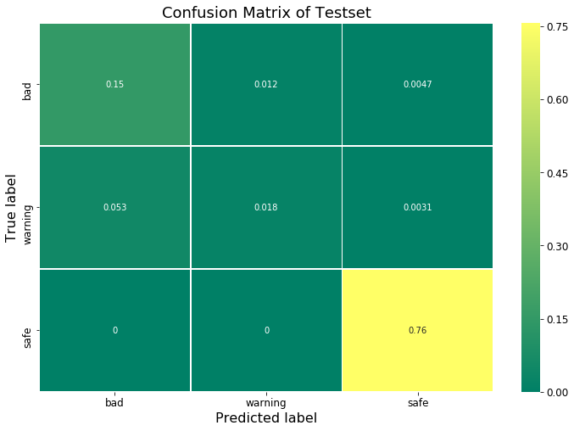
DEEP LEARNING MODEL
CONFUSION MATIX – MULTI-CLASS CLASSIFICATION

Slide 16
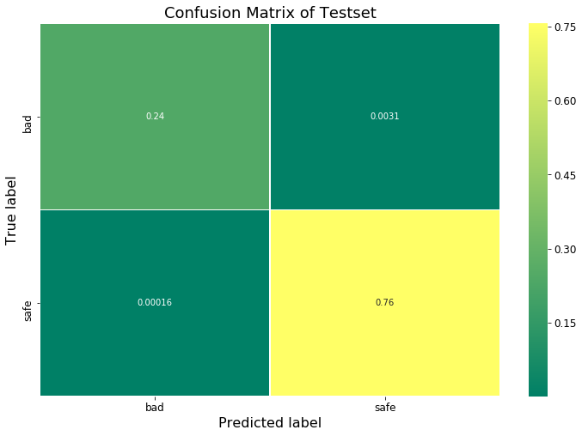
DEEP LEARNING MODEL
CONFUSION MATIX – BINARY CLASSIFICATION

Slide 17
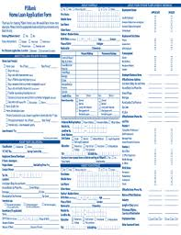
MANUAL LOAN PROCESSING SYSTEM
Loan Applications
Risky
Loan Application Review System
Risky
Safe

Slide 18
FUTURE ENHANCEMENTS
Develop an automated loan approval system with borrower’s status notification
Alerts:-
Define Threshold
If Loan Status is 1 ----- ‘Risky Borrower’ signal
If Loan Status is 0 ----- ‘Safe Borrower’ signal
Alert System
SMS via Twillo
Email

Slide 19
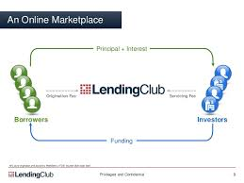
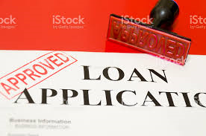








Future Enhancement
Loan Processing System
Approved
Safe
Machine Learning Model
Classifier Model
Presentation
Loan Status Chart
SMS/Email
Risky
Data collection and pre-processing
Store results in a SQL database
Rejected

Slide 20
OPPORTUNITIES FOR IMPROVEMENT
Get additional data to have a better prediction
Ex: - Zip code in the current dataset could not be used as the last 2 digits were coded as ‘xx’. If we had the correct zip code’s , we could have used additional demographics data based on the zip code.
Use additional models
Evaluate models not just on accuracy, but also speed
Cleaner code, probably have well defined functions/packages

